Slide 1

Chicago Crime Analysis: Theft
Kevin Chea, Tony Lieu
Notes:
Tony

Slide 2


Overview
Objective: Use Hive to break down and analyze information regarding theft-related crimes in Chicago
Attempt to answer the following:
What type of thefts are occurring?
When are they occurring?
Where are they occurring?
Notes:
Kevin

Slide 3
The data
Data sourced from Chicago Police Department's CLEAR (Citizen Law Enforcement Analysis and Reporting) system
Consists of Chicago crime data from 2001 to present day
CSV file approximately 1.54 GB in size (uncompressed)
22 columns, 6.76 million rows
Data source: https://data.cityofchicago.org/Public-Safety/Crimes-2001-to-present/ijzp-q8t2
Notes:
Kevin

Slide 4
Hardware specifications
Oracle Big Data Compute Edition: 5 nodes
OCPUs: 10
CPU Speed: Intel(R) Xeon(R) CPU E5-2699C v4 @ 2.20GHz
Memory: 150GB
Storage: 678 GB
HDFS Capacity: 147 GB
Notes:
Tony

Slide 5
workflow
Download data from cityofchicago.org
into HDFS
Use Hive to create tables and perform queries on theft crimes
Export findings
Use results to create charts and graphs for analysis
Perform a geospatial analysis using Fusion Tables
Notes:
Tony

Slide 6
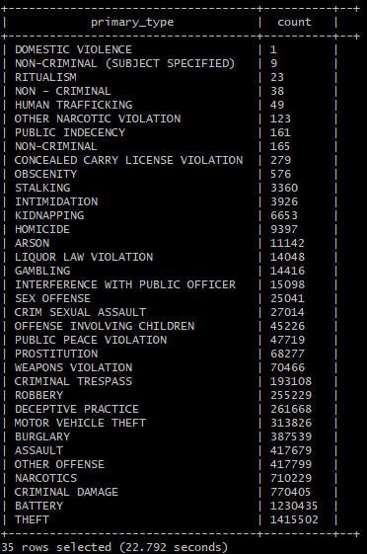
Creating Tables
CREATE EXTERNAL TABLE IF NOT EXISTS chicagocrimes(
id BIGINT,
case_number STRING,
`date` STRING,
block STRING,
iucr STRING,
primary_type STRING,
description STRING,
location_description STRING,
arrest STRING,
domestic STRING,
beat STRING,
district STRING,
ward STRING,
community_area INT,
fbi_code STRING,
x_coordinate BIGINT,
y_coordinate BIGINT,
year INT,
updated_on STRING,
latitude FLOAT,
longitude FLOAT)
ROW FORMAT DELIMITED FIELDS TERMINATED BY ','
STORED AS TEXTFILE LOCATION '/user/tlieu/ChicagoCrimes’;
SELECT primary_type, COUNT(*) AS `count`
FROM chicagocrimes
GROUP BY primary_type
ORDER BY `count`;
Notes:
Tony

Slide 7
Crime breakdown: 2001-present
Theft is the most common type of crime in Chicago (1415502 records total)
Note: Vehicles thefts are categorized separately
Notes:
Kevin

Slide 8
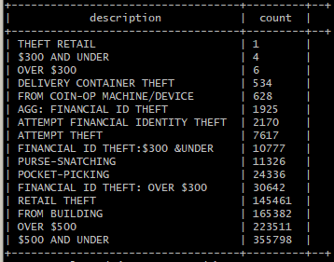
Creating Tables
SELECT description, COUNT(*) AS `count`
FROM chicagocrimes
GROUP BY description
ORDER BY `count`;
Notes:
Kevin

Slide 9

Most common thefts
Notes:
Kevin

Slide 10
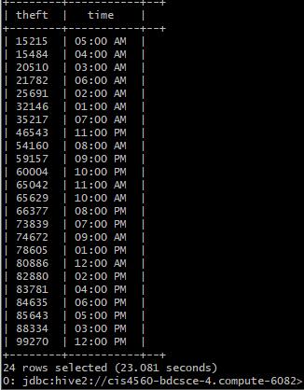
Creating Tables
SELECT count(primary_type) as theft,
date_format(`date`, "hh:00 aa") as time
FROM cc
WHERE primary_type ='THEFT'
GROUP BY date_format(`date`, "hh:00 aa")
ORDER BY theft;
Notes:
Tony

Slide 11
Thefts by the hour
Notes:
Tony

Slide 12
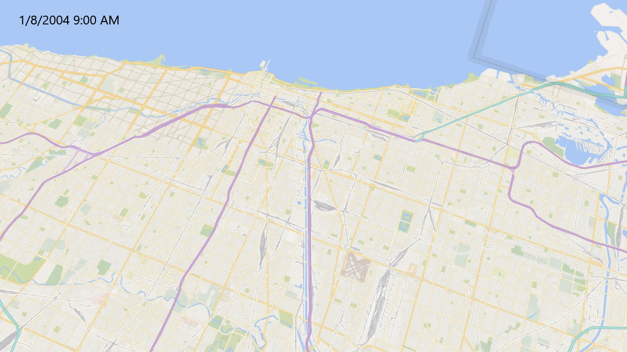
January 8th, 2004 time-lapse
Notes:
Kevin

Slide 13
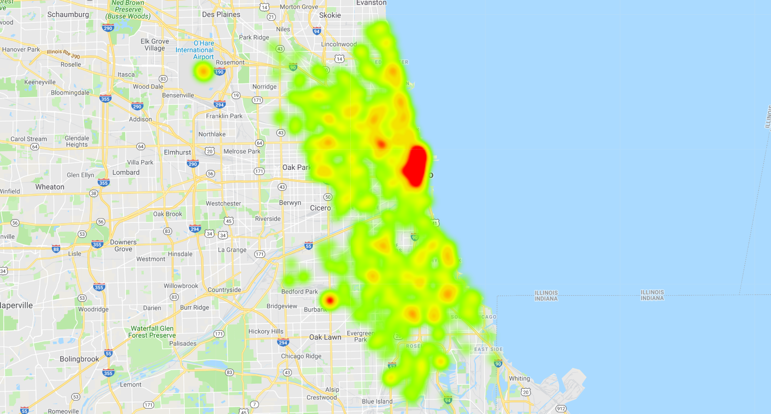
Theft heatmap
2001 – Present
9AM – 9PM
Generated using Google Fusion Tables
Notes:
Kevin

Slide 14
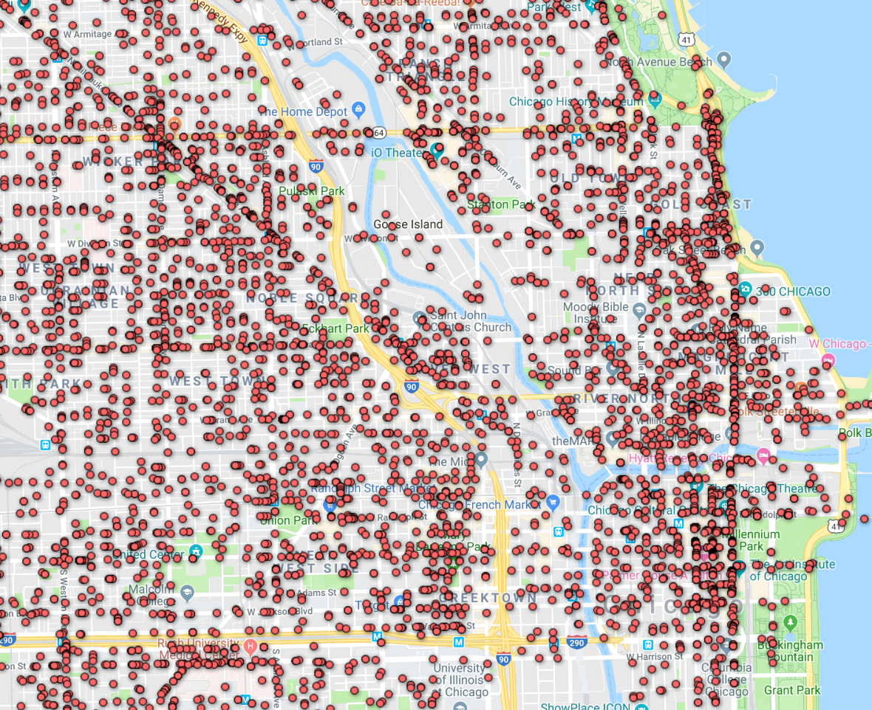
Downtown Chicago, with each incident individually plotted
Notes:
Kevin

Slide 15
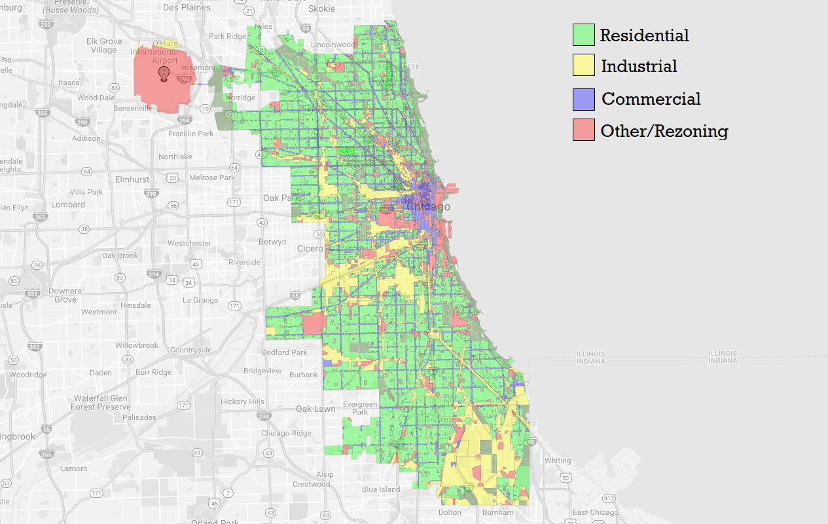
Chicago Zoning Map (as of Sept. 2017)
Source: 2nd City Zoning
Notes:
Kevin

Slide 16
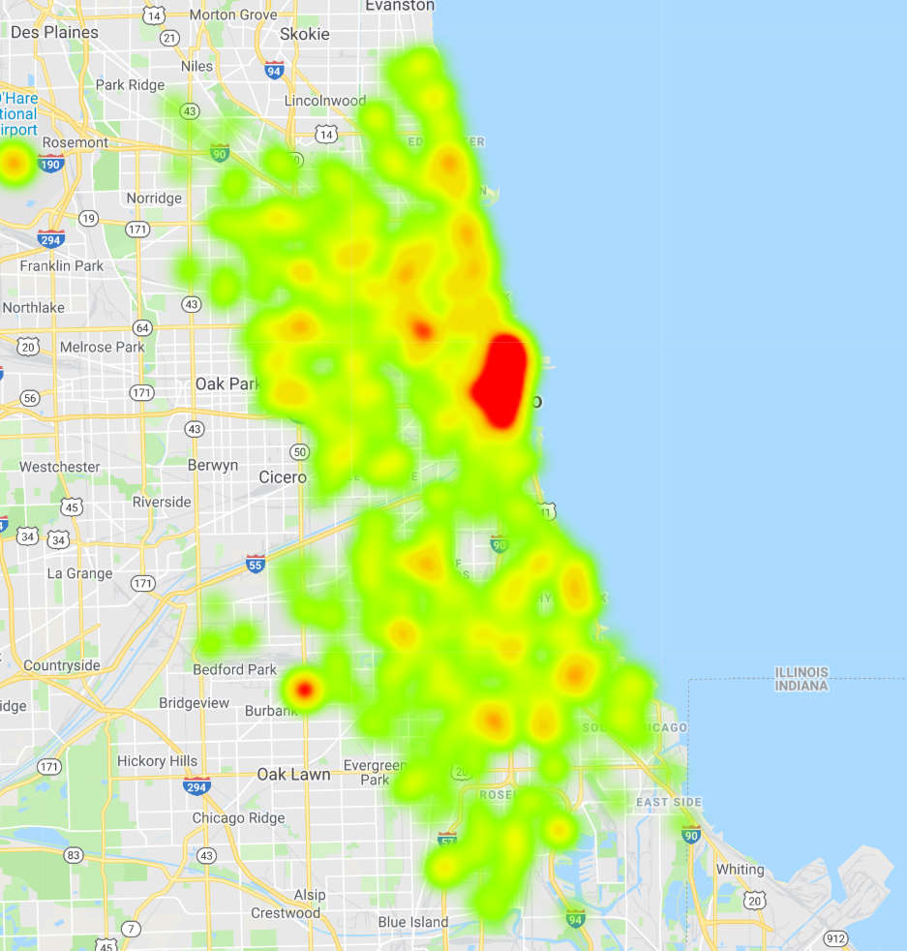
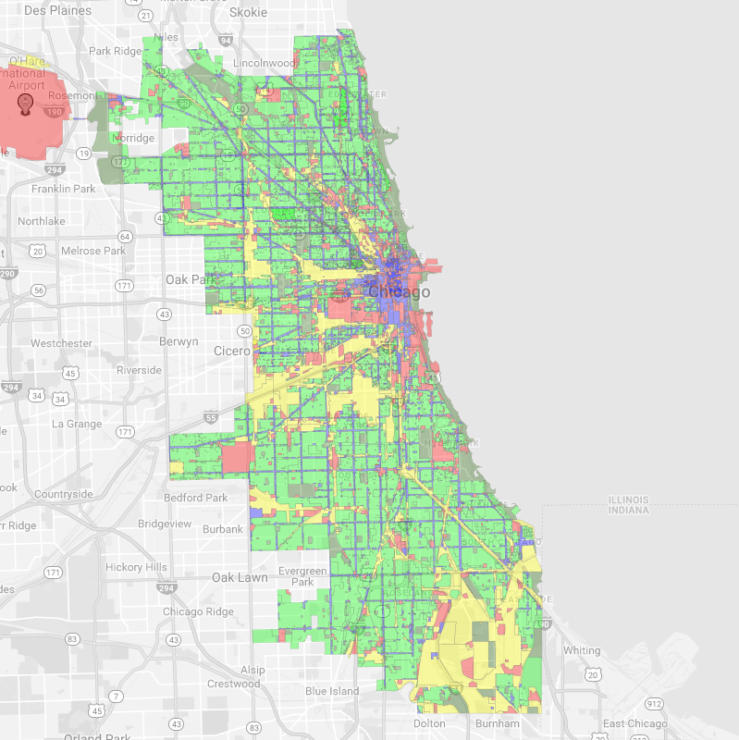
Notes:
Kevin

Slide 17
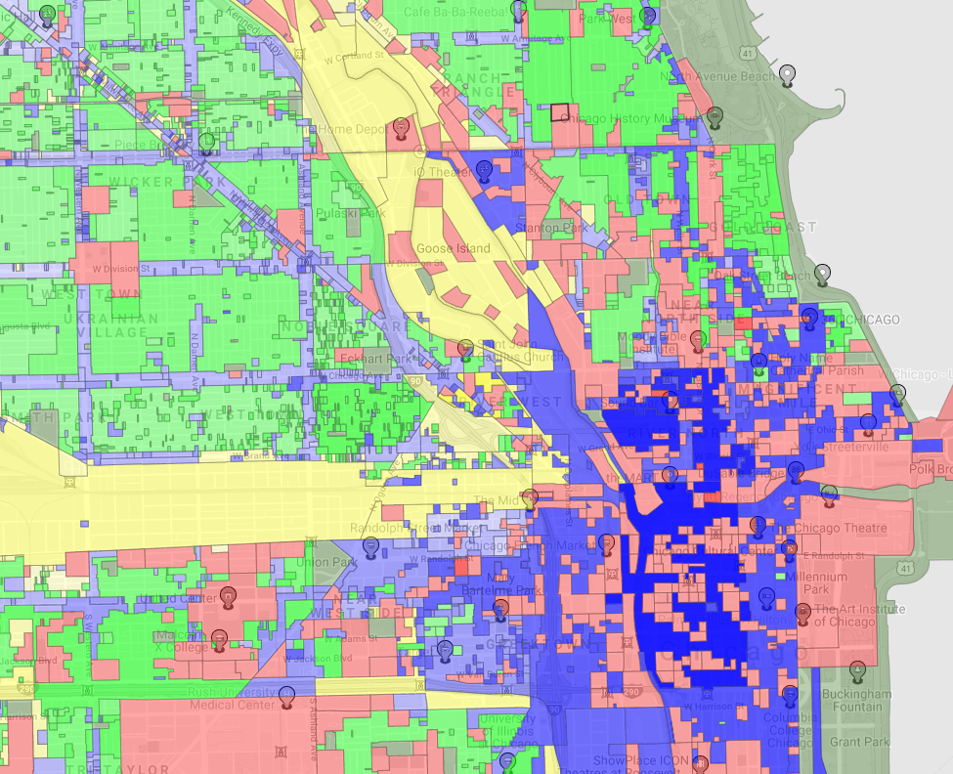
Commercial areas experience a higher concentration of thefts
However, more thefts occur in non-commercial areas overall
Notes:
Kevin

Slide 18
summary
Theft is the most common type of crime in Chicago
Majority of thefts are valued under $500
Most likely to occur between the hours of 9AM and 9PM
Commercial areas see a higher concentration of incidents, but majority of thefts occur outside of commercial areas
Notes:
Tony

Slide 19
Documentation
Github page for related codes and documents: https://github.com/Tonylieu833/CIS-4560

